Slide 1


Getting around Ethiopia just got easier. Much easier.
E-ADRASHA
Tewodros Hailegeberel | Tewodros Zerihun | Tewodros Nega | Nolawi Taddesse | Robel Kassa
December 15, 2017
Confidential and Proprietary. Copyright (c) by E-Adrasha. All Rights Reserved.

Slide 2

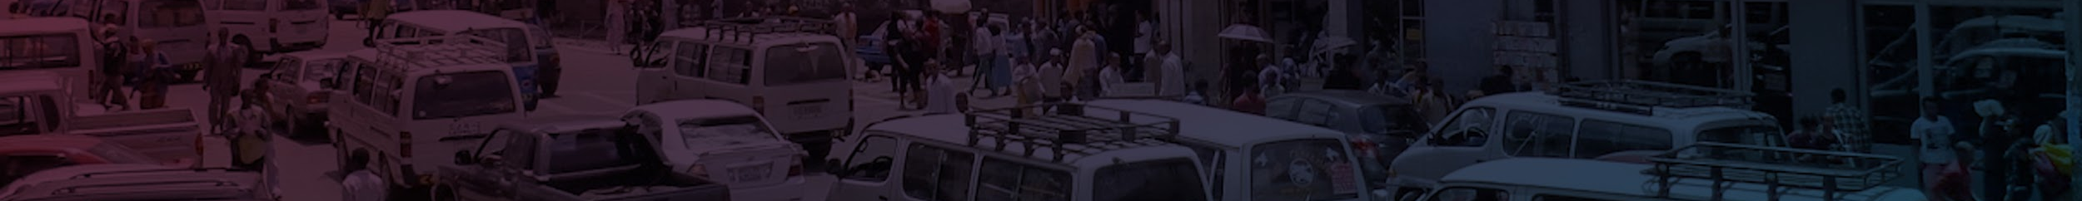
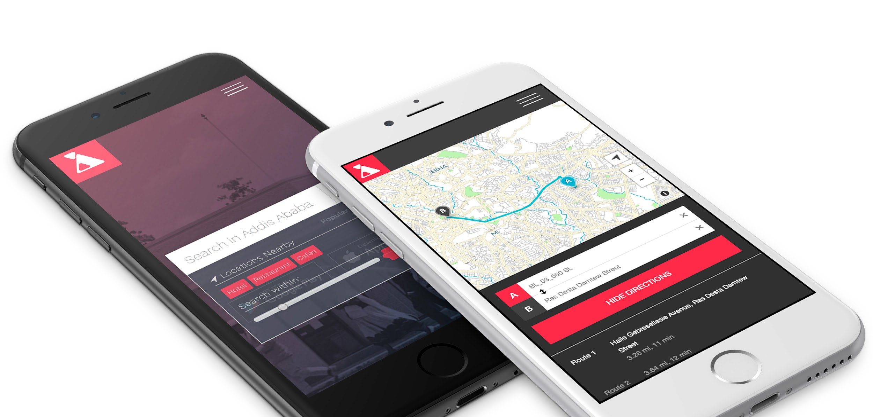
Mission statement:
Mobility in Ethiopia now made easy.
Never get lost, or rely on landmarks and word-of-mouth.
Door-to-door directions for residential, commercial, and governmental locations.

Slide 3
Team
Tewodros Hailegeberel
Tewodros Nega
Nolawi Taddesse
Tewodros Zerihun
Robel Kassa
COO & Founder (Database manager, Data Collection)
CFO
CTO
Communication Director
Creative Director
12 years experience in Geospatial and database management
CPA with 5 years experience in accounting and finance
Owns Zerihun Associates in Addis Ababa, Ethiopia
5 years experience in mobile application development and software development
Developed Agergna App (Amharic Keyboard App)

Slide 4
The Problem
Ethiopia is in the midst of transforming into a middle income country. To get location data in Addis Ababa, Ethiopia, users rely on word of mouth information to find their destination and other information. Taxis often have to rely on their passengers to get to their destination if they don’t know the area very well.
Currently there is no digital platform that will provide location based information for any type of consumer to use.
Some locations and roads are also not well known by everyone in the city, thus getting round the city is very hard because most people rely on known information. If a new road is constructed and it’s the easiest path to their destination, people will not be able to know about it.

Slide 5
The Solution
We are collecting over 300 type of categories like:
Schools
Government offices
Buildings with building names
Hospitals
Clinics
Condos
Residential homes, and more
Using this data, we’ve created a geolocator that will enable users to find their destination or locations.
We’ve also enriched the data by adding hours of operation for business and foot traffic data, car parking information, number of seats a business has. We believe this information will help users and business to use our data.
Out data and application is multi language where users can search using native language (Amharic).

Slide 6
The Advantage
We are one of a kind startups in Addis Ababa with a large amount of data collected in the city.
We also have the ability to quickly add data to our database when there is a change in the city.
The current city and government administration have accepted our solution for finding information using mobile application.
Because we have started the data collection and built a mobile app, we are in a good position to take advantage of working with government agencies and business.

Slide 7
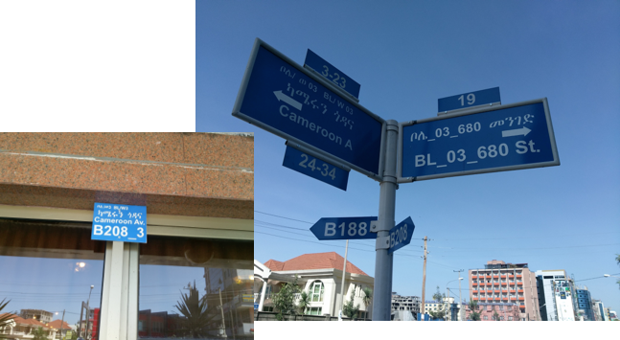
Background
Street Signs in Addis Ababa

Slide 8
Background
We utilize open source products:
-Open Street Map – using it as a basemap
-Open Street Map Directions for routing- The based on the mathematical formula used. optimization model is derived from the precise mathematical procedures that offer the best or optimum solution
-Data collection tools -Kobo Collect
-Database - Postgresql an open source object-relational database system
-QGIS- cross-platform free and open-source desktop geographic information system application that supports viewing, editing, and analysis of geospatial data.

Slide 9
Background
We utilize ESRI products as well
ArcMap to digitize some of the roads and create field maps for data collectors to idenitfy which areas to focus their data collections
ArcGIS Online to create web maps to communiticate data errors with the ground field crew
ESRI Collector app to give our field crew the ability to locate data and fix the error based on the data collected
ESRI market place (Future) provide geocoders and data

Slide 10
How it works for users
Step 1
Download The App
Step 2
Search for location
Step 3
Get Direction
Find the location and more info

Slide 11
Revenue Model
Our Revenue Model
We will give the app as a free app but will include ads as banners
We are also planning to add business listing services using location based information.
We will also provide consultancy services to business and government agencies
Banner Ads
Business listing services
Consultancy
Data provider model (API)

Slide 12
Benefits of Our Application
Adrasha’s location information for businesses, residences, facilities, tourist attractions or anything in the city is an addition to public welfare.
All users can benefit in finding commercial and public services as well as driving navigation to POIs needed, with real-time traffic information.
We are providing data plus logistic services to both clients and customers.
Transit
Real-time driving navigation routes, with traffic updates and travel time.
Goods & Services
Efficient and updated routes for delivery and pick-up of freight, goods, and services.
Tourism
Directions to historical and cultural sites, markets, and several tourist attractions, commercial, government locations.
Notes:
Societal benefits- Geospatial technology can play a role in emergencies—such as helping people prepare for a natural disaster by highlighting flood-risk areas.
Consumer benefits
Geo-spatial Maps help increase efficiency and reduce travel time
Business benefits
Maps help make small and large businesses more visible, productive and profitable. By providing useful facts such as store hours, contact information and reviews, maps help drive sales—particularly important for small businesses that may find potential new customers without incurring additional advertising costs.

Slide 13
Benefits of Our Application & Data
Type of Services or applications can be developed with our data and app
Call centers can locate their clients (households) to find where there are shortages and send the contractor or inspector to the right house without having to guess where the house is located
Our data can be used to identify areas that experience utility outage like internet outage to identify the cause and quick response.
We can develop a database for all assets that will be used to track where their assets are located and the condition of the assets
Identify houses that are under government rental houses and find which houses need repairs and which houses are up for rental

Slide 14
Possibilities of our data use
Emergency -Route Optimization for emergency management agencies
Determining locations as well as best route for getting to fire emergencies
Ambulance services for hospitals
Utilities Based services - Assist tracking in water leakage and problems ….and electrical issues For instance for Addis Ababa Water Authority and The ELPA
Logistic/shipping and tourism markets- Improving local delivery by the Ethiopian Post Office, DHL, FedEx or Local Shipping EMS and Ethiopian tourism agency.

Slide 15
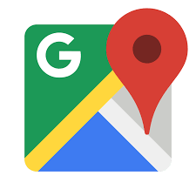


Competition
Google Map AddisMap.com Zuret App

Slide 16
Contact
Tewodros Hailegeberel
E-Mail: t.Hailegeberel@eadrasha.com
US Phone: +1 240-483-2461
Ethiopia Phone: +251 929 123944

